Slide 1
Jalasoft Automation Methodology - Overview

Slide 2
Contributors
This document has been created by people with many years doing automated testing for Jalasoft’s projects
Gonzalo Alba
Raul Garvizu
Nedsayde Escalera
Jafeth Garcia
Wilge Vargas
Silvia Valencia
Danny Flores

Slide 3
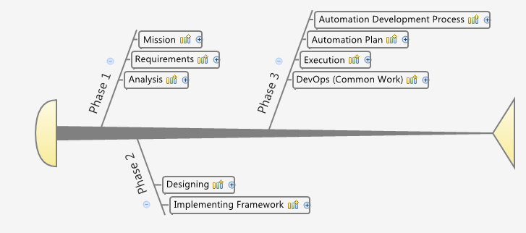
Project Automation Flow

Slide 4
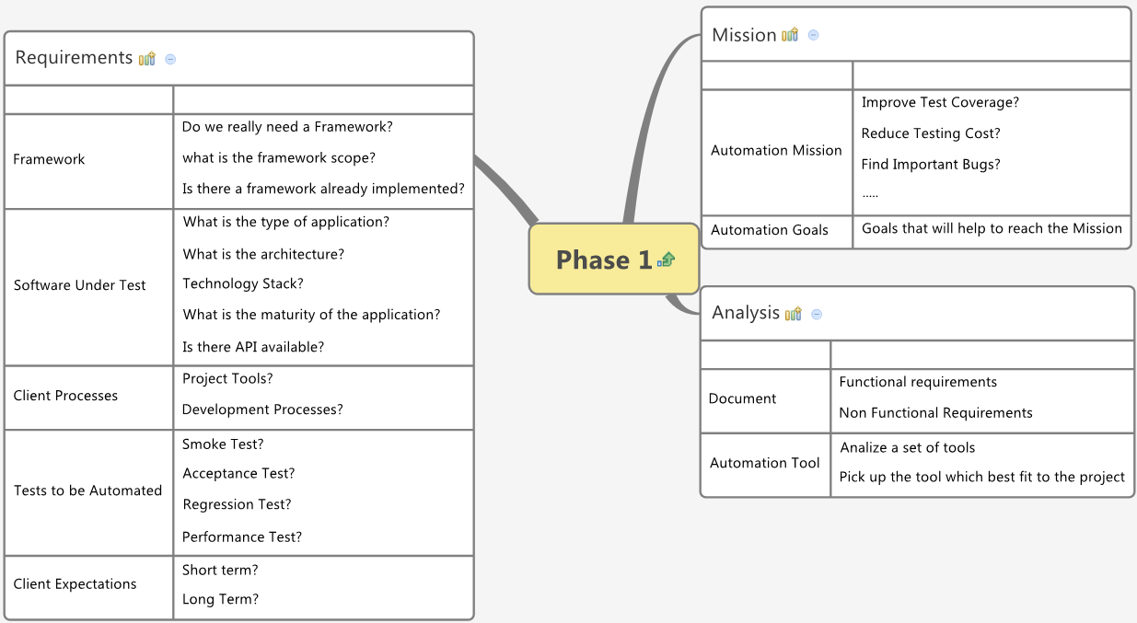
Phase 1

Slide 5
Phase 1 - Outcome
Mission
Automation Scope
Project Oriented
Product Line Oriented
Enterprise Oriented
Automation Requirements
Functional
Non Functional
Automation Tool
Project Plan (High Level)

Slide 6
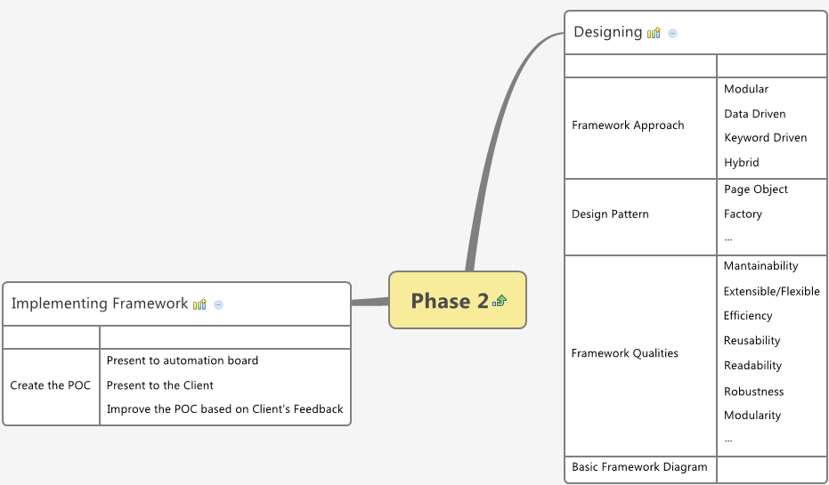
Phase 2

Slide 7
Phase 2 – Outcome
Proof of Concept (POC)
From Demo to the client
Additional Requirements
Automation and client’s doubts clarified
Improvements to be done in Automation (Functional and Non Functional)
Help from client side
SUT’s API
SUT’s DB
Hooks in the SUT
Automation going to the right direction

Slide 8
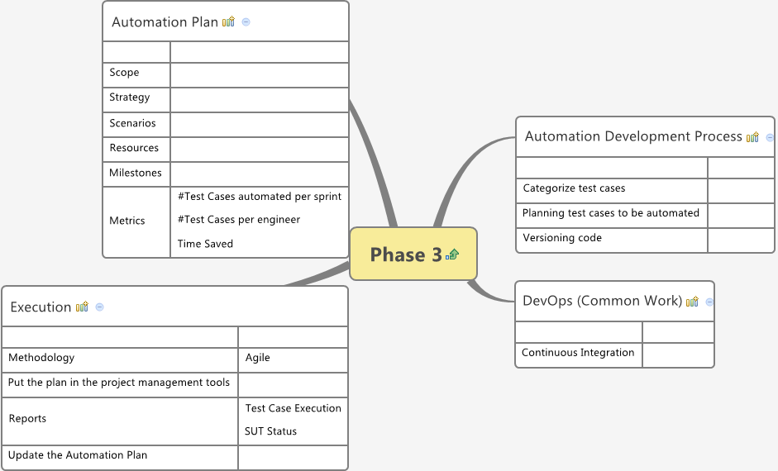
Phase 3

Slide 9
Phase 3 - Outcome
Automation Plan
Development Process Defined
Everyone “speaking” the same language
Automation Reports
Automation Metrics
DevOps (Common task)
Integration
Automation Project Under Control

Slide 10
Successful Automation Project

Slide 11


Slide 12


